Slide 1
Application 19.09-10
Project Duration

Slide 2
Application 19.09
Determining Minimum Project Duration

Slide 3
Introduction
Problem type : Shortest path problem
Reference : The Economic Lot Scheduling Problem (ELSP): Review and Extensions
[S. E. Elmaghraby, Management Science, Vol. 24
No. 6, February 1978, pp. 587-598]
The ELSP is a time-honored problem that “has been around” since 1915
Notes:
ELSP問題從1915年開始被廣泛討論
是幾個產品在單一機器做週期性生產的問題
每批為每個商品
每批應如何生產(安排時間)
假設生產速率固定

Slide 4
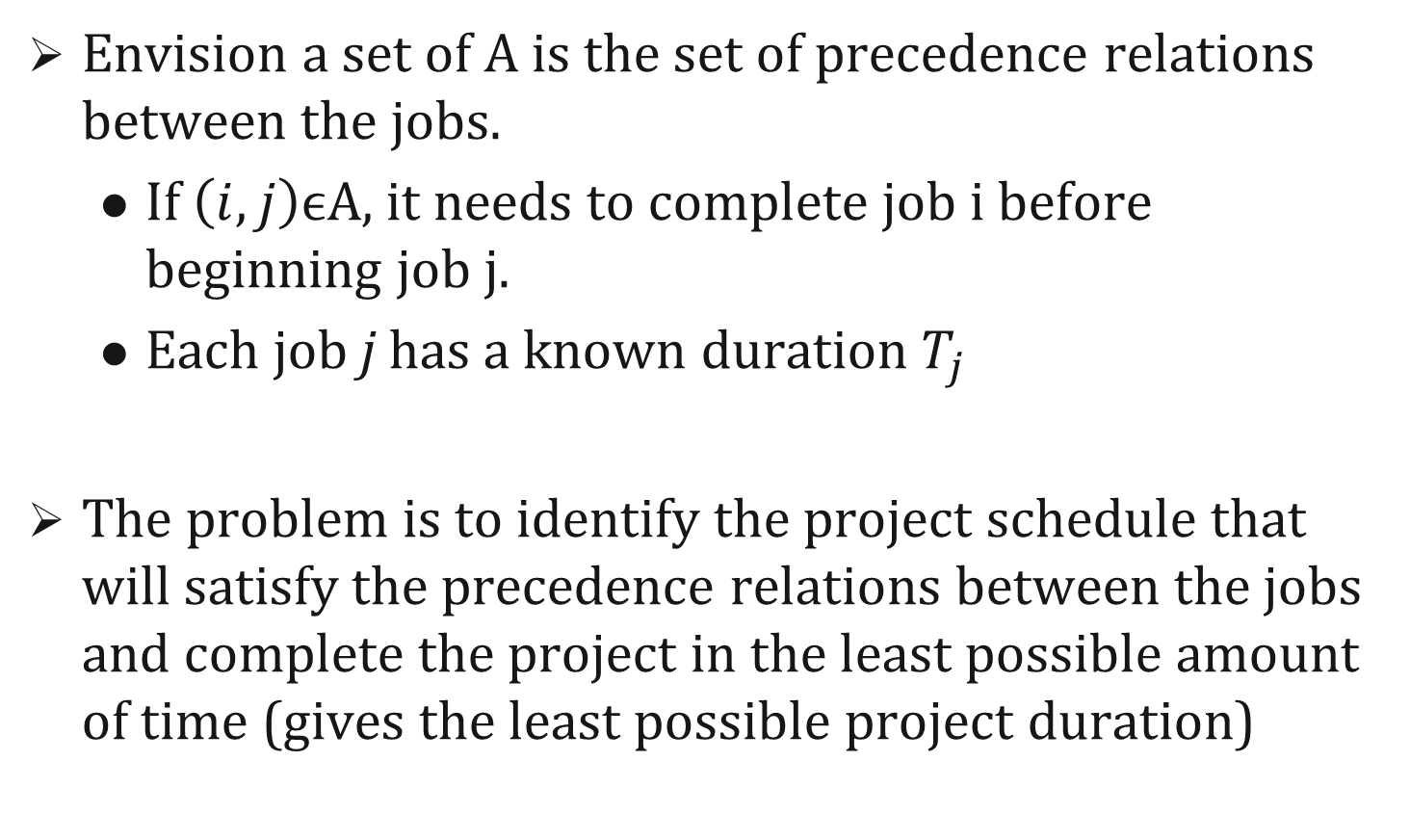
Introduction
Envision a set of A is the set of precedence relations between the jobs.
If $\left(i,j\right)$ϵA, it needs to complete job i before beginning job j.
Each job j has a known duration $T_{j}$
The problem is to identify the project schedule that will satisfy the precedence relations between the jobs and complete the project in the least possible amount of time (gives the least possible project duration)
Notes:
ELSP問題從1915年開始被廣泛討論
是幾個產品在單一機器做週期性生產的問題
每批為每個商品
每批應如何生產(安排時間)
假設生產速率固定

Slide 5
Related Word
There are two alternative method to solve the problem :
1. represent jobs by arcs(more popular)
2. represent jobs by nodes (simpler)
* the first approach is more popular in the literature
* the application adopt the second approach in the
discussion(it is conceptually simpler)

Slide 6
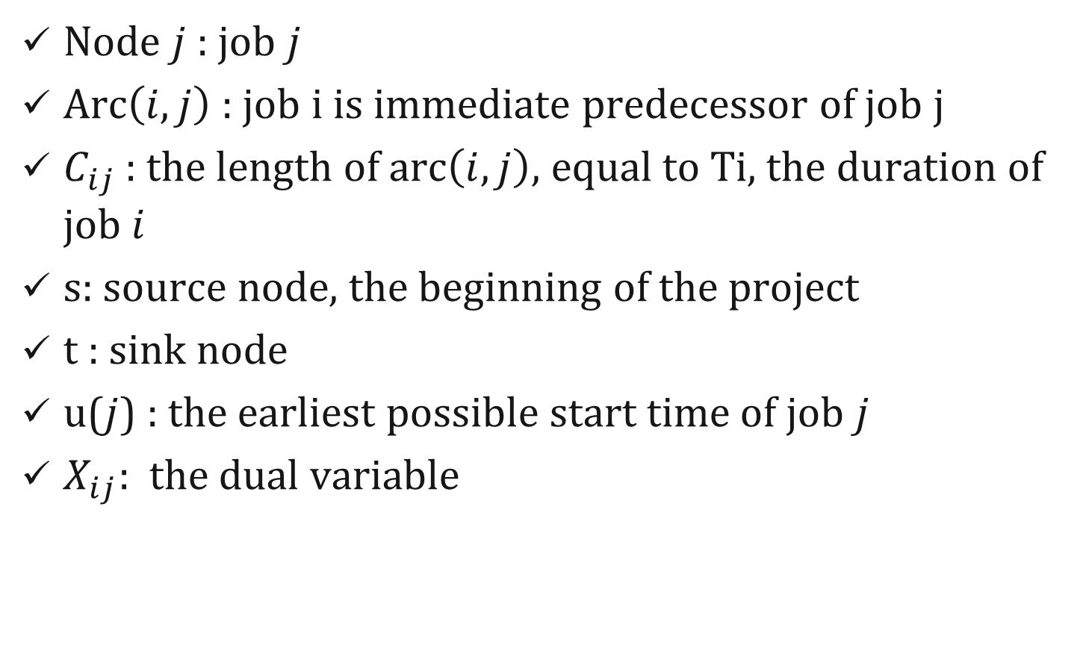
Solution
Node $j$ : job $j$
Arc$\left(i,j\right)$ : job i is immediate predecessor of job j
$C_{ij}$: the length of arc$\left(i,j\right)$, equal to Ti, the duration of job $i$
s: source node, the beginning of the project
t : sink node
u($j$) : the earliest possible start time of job $j$
$X_{ij}$: the dual variable

Slide 7
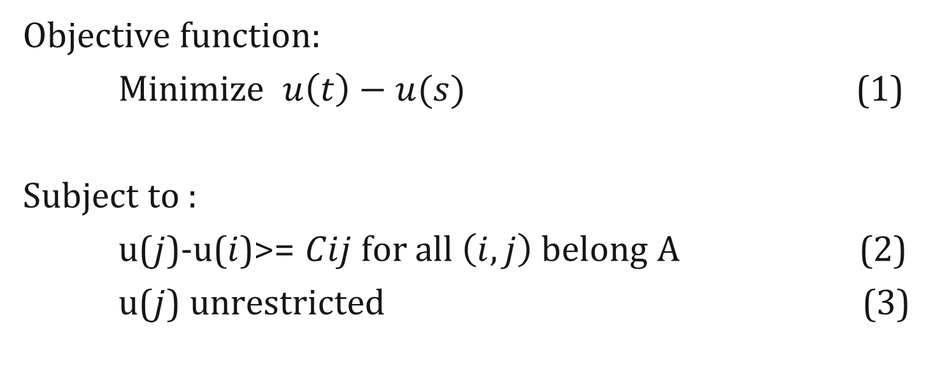
Solution
Objective function:
Minimize $u\left(t\right)−u(s)$ (1)
Subject to :
u($j$)-u($i$)>= $Cij$ for all $\left(i,j\right)$belong A (2)
u($j$) unrestricted (3)
Notes:
Function u 是每個工作的開始時間

Slide 8
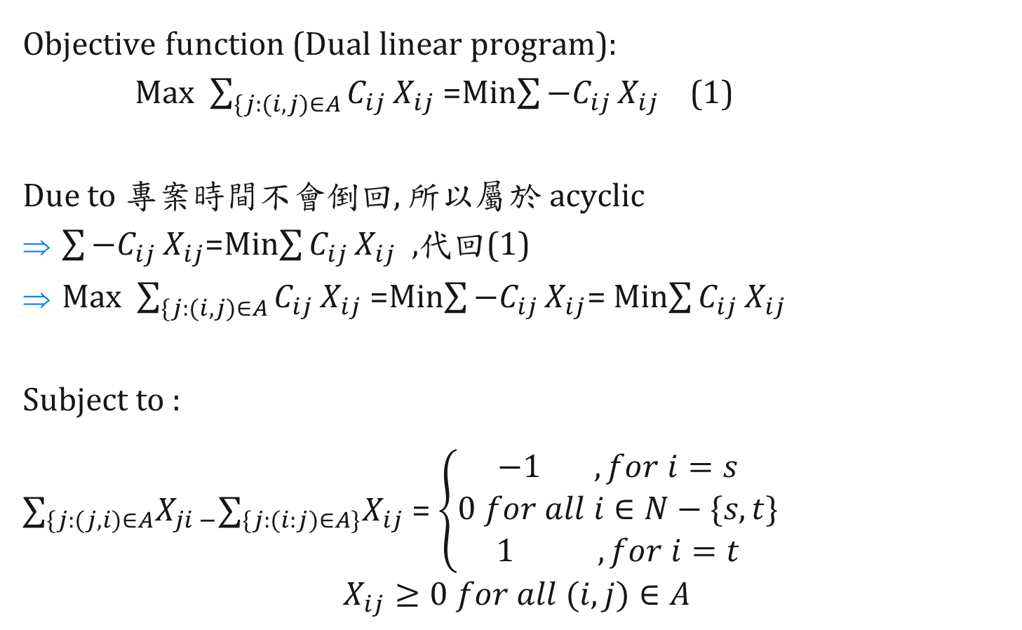
Solution
Objective function (Dual linear program):
Max $\sum_{\{j:(i,j)∈A}{C_{ij}}X_{ij}$ =Min$\sum{−C_{ij }X_{ij}}$ (1)
Due to 專案時間不會倒回, 所以屬於 acyclic
$\sum{−C_{ij }X_{ij}}$=Min$\sum{C_{ij }X_{ij}}$ ,代回(1)
Max $\sum_{\{j:(i,j)∈A}{C_{ij}}X_{ij}$ =Min$\sum{−C_{ij }X_{ij}}$= Min$\sum{C_{ij }X_{ij}}$
Subject to :
$∑_{\{j:(j,i)∈A}X_{ji −}∑_{\{j:(i:j)∈A\}}X_{ij}$ = $\left\{\begin{aligned}−1 , for i=s \\ 0 for all i∈N−\{s,t\} \\ 1 , for i=t\end{aligned}\right.$
$$X_{ij}≥0 for all (i,j)∈A$$
Notes:
Function u 是每個工作的開始時間

Slide 9
Application 19.10
Just-in-time Scheduling

Slide 10
Introduction
Problem type : Shortest path problem extension
Reference : A network flow algorithm for just-in-time project scheduling
[E.V. Levner, A.S. Nemirovsky, 1994, European Journal
of Operational Research, 79, pp. 167-175]
To eliminate the waste of just-in-time scheduling
Related problem: project management, schedule
Notes:
ELSP問題從1915年開始被廣泛討論
是幾個產品在單一機器做週期性生產的問題
每批為每個商品
每批應如何生產(安排時間)
假設生產速率固定

Slide 11

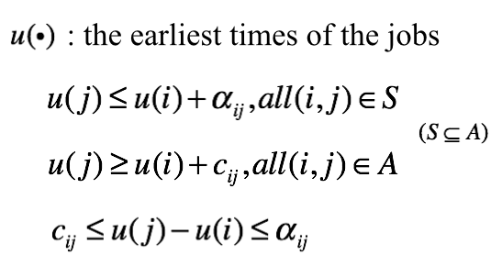
Related Word
i
j
Minimum∑▒〖𝐶_(𝑖𝑗 ) 𝑋_𝑖𝑗 〗

Slide 12
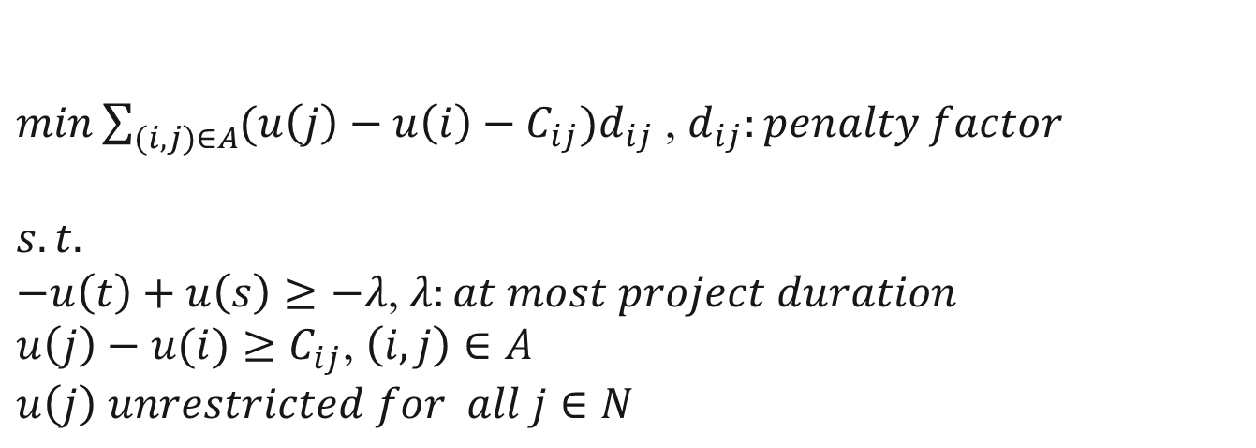
Transform to LP model
1
2
s
t
3
4
$min\sum_{(i,j)∈A}{(u\left(j\right)−u\left(i\right)−C_{ij})d_{ij}}$ , $d_{ij}:penalty factor$
$$s.t.$$
$−u\left(t\right)+u\left(s\right)≥−λ$,$λ:at most project duration$
$u\left(j\right)−u(i)≥C_{ij}$, $\left(i,j\right)∈A$
$$u\left(j\right) unrestricted for all j∈N$$

Slide 13

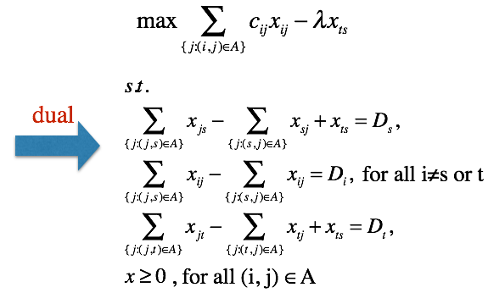
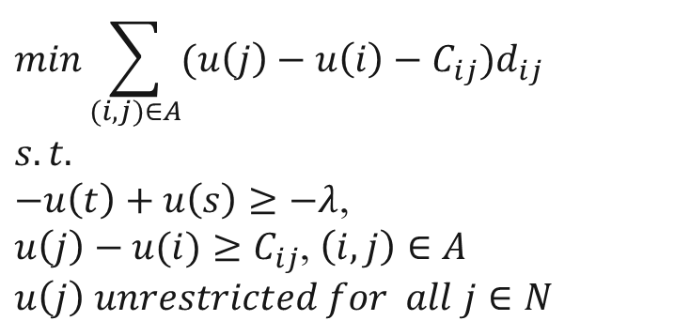

Transform to LP model
$$min\sum_{(i,j)∈A}{(u\left(j\right)−u\left(i\right)−C_{ij})d_{ij}}$$
$$s.t.$$
$−u\left(t\right)+u\left(s\right)≥−λ$,
$u\left(j\right)−u(i)≥C_{ij}$, $\left(i,j\right)∈A$
$$u\left(j\right) unrestricted for all j∈N$$
$$−λ$$
1
2
s
t
3
4
Notes:
Function u 是每個工作的開始時間

